Slide 1
DESAIN WEB
Jihadul Akbar
Persiapan dan Pengenalan HTML

Slide 2
Cakupan Materi
Persiapan Sofware yang di butuhkan untuk praktik perkuliahan
Definisi dan Sejarah HTML
Struktur HTML

Slide 3
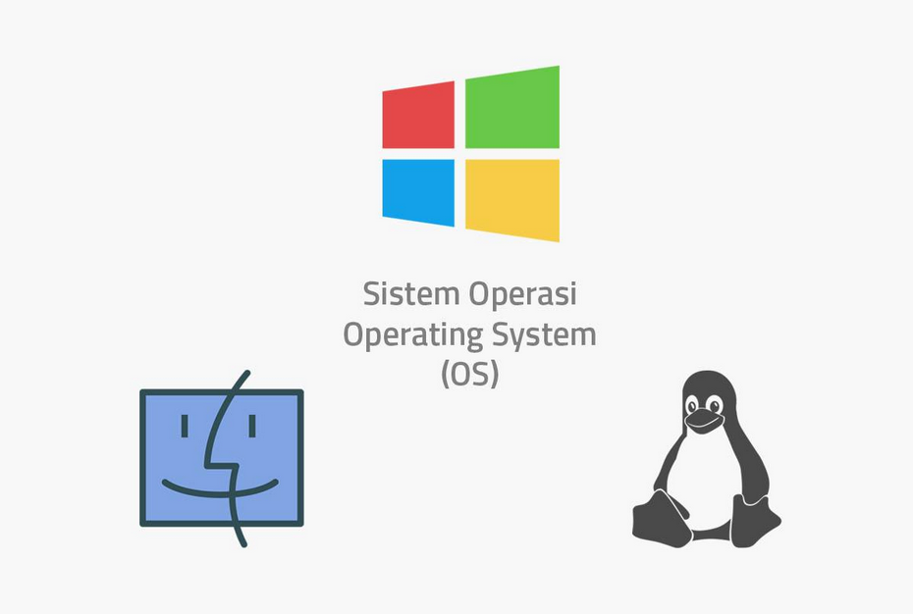

Slide 4


Slide 5
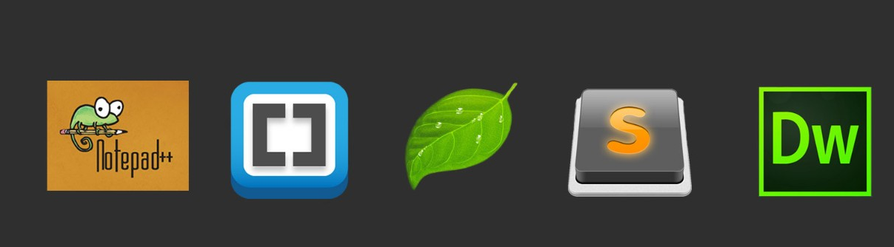



Slide 6
<HTML>
Hypertext Markup Language

Slide 7
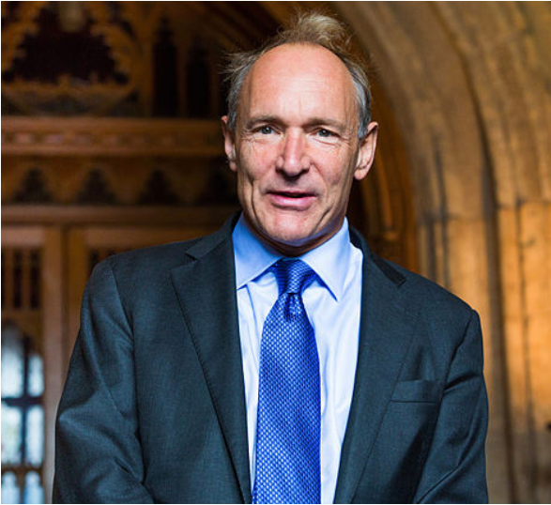
Tim Berners-Le

Slide 8
Penemu
HTTP
HTML
WWW
Web Browser
Web Server
Web Page

Slide 9

World Wide Web Consortium
https://www.w3.org/

Slide 10
What is HTML?
HTML stands for Hyper Text Markup Language
HTML describes the structure of Web pages using markup
HTML elements are the building blocks of HTML pages
HTML elements are represented by tags
HTML tags label pieces of content such as "heading", "paragraph", "table", and so on
Browsers do not display the HTML tags, but use them to render the content of the page
https://www.w3schools.com/html/html_intro.asp

Slide 11
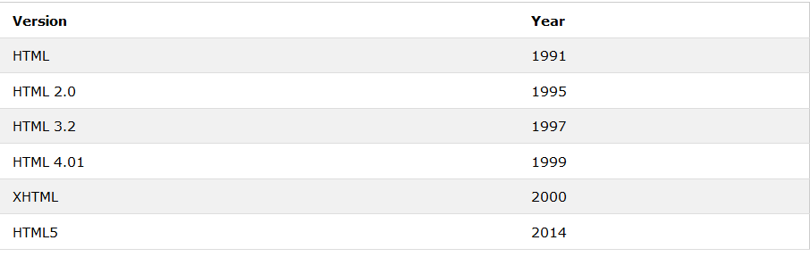
Version HTML?
https://www.w3schools.com/html/html_intro.asp

Slide 12

Web Browser

Slide 13
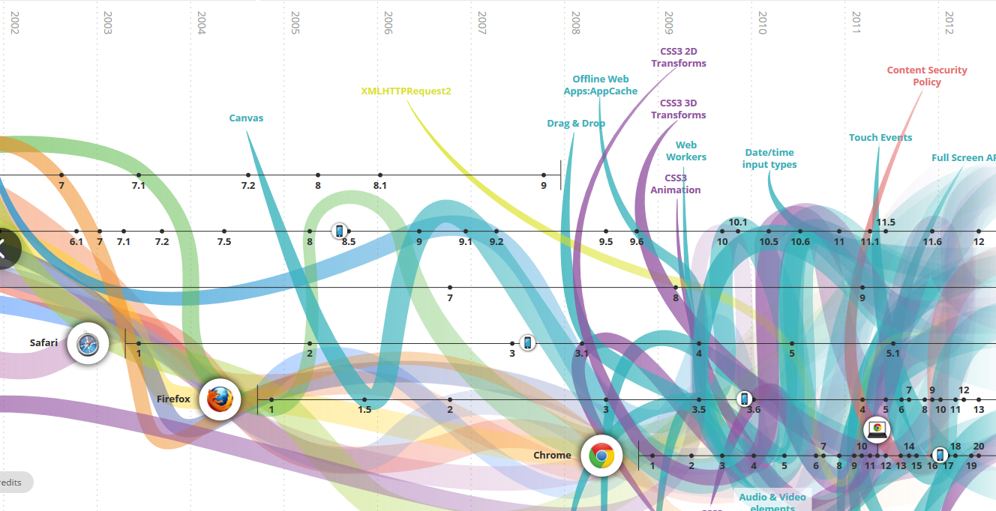
Perkembangan Teknologi Internet
http://www.evolutionoftheweb.com/

Slide 14

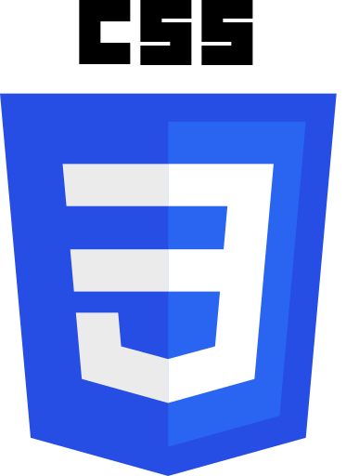


Slide 15



+
+
HTML
CSS
Javascript

Slide 16
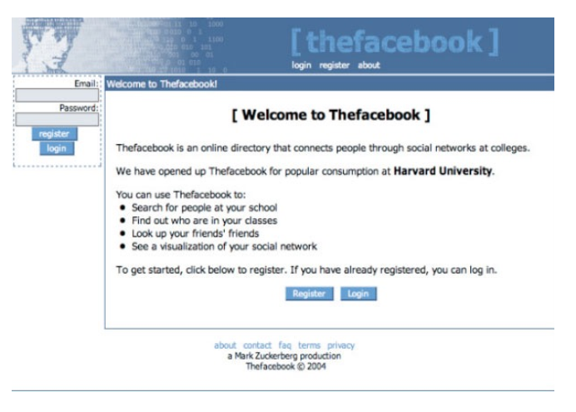

Slide 17
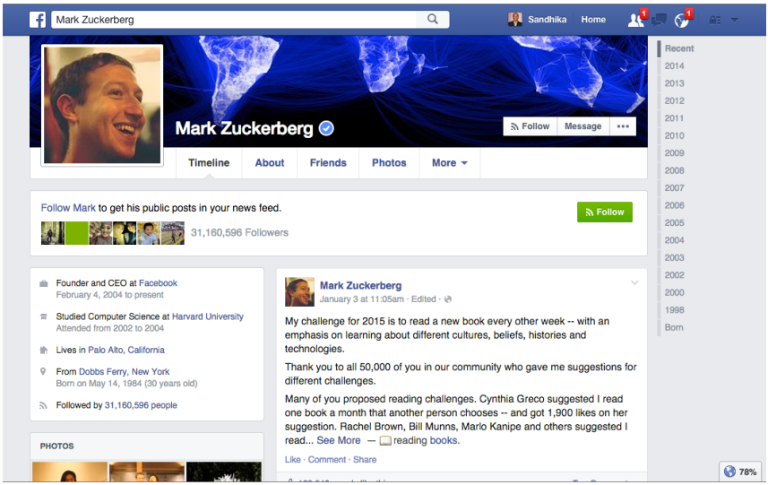

Slide 18
< Let’s Code >
Hello World

Slide 19

Sublime Text 3
https://www.sublimetext.com/

Slide 20
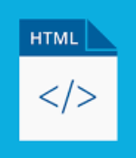
namafile.html

Slide 21
kerangaka
<HTML>

Slide 22
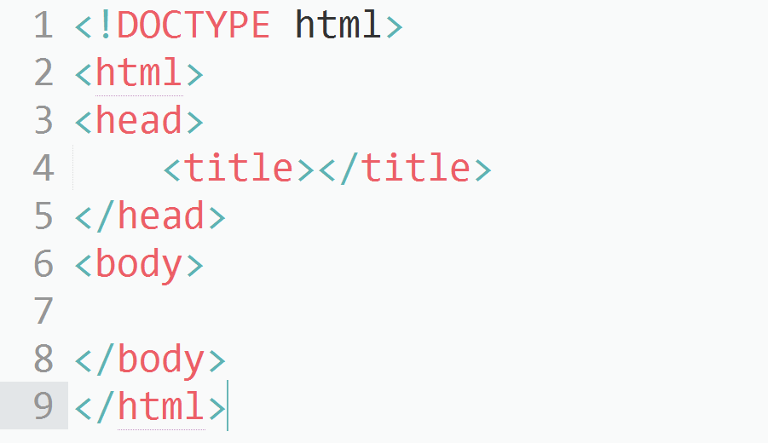

Slide 23
bagian
<head>

Slide 24
- Judul halaman
<title></title>
CSS
<style></style>
Javascript
<script></script>
Metadata
<meta></meta>

Slide 25
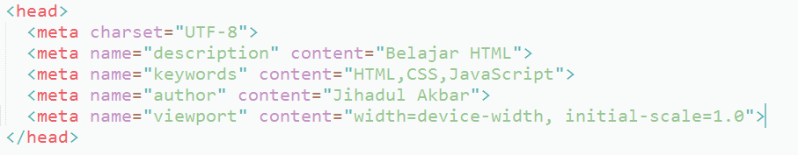
metadata

Slide 26
bagian
<body>

Slide 27
- teks
<h1>, <h2>, <h3>, <h4>, <h5>, <h6>, <p>, …
- pendukung teks
<br>, <hr>, <em>, <strong>, …
- gambar
<img>
- hyperlink
<a>
- list (bullets & numbering)
<ul>, <ol>, <li>, <dl>, <dt>, <dd>

Slide 28
- tabel
<table>, <thead>, <tbody>, …
- form
<form>, <input>, <select>, <button> …
- script
<script>
- object
<object>
- grouping
<div>, <span>

Slide 29
komentar
<!-- isi komentar-->

Slide 30
struktur
tag

